Slide 1
No | ID | Name | area | perim | x | y | x-LC | y-LC | Iyy | Ixx | Ixy | Ixx0 | Iyy0 | Ixy0 | theta | Imin | Imax | Rmin | rmax
1. | 18 | Alu0 | 36.00 | 24.00 | 3.00 | 3.00 | 3.00 | 3.00 | 432.00 | 432.00 | 324.00 | 108.00 | 108.00 | 0.00 | 45.00 | 108.00 | 108.00 | 1.73 | 1.73
2. | 27 | Alu1 | 35.95 | 23.57 | 3.00 | 3.00 | 3.00 | 3.00 | 431.05 | 431.05 | 323.52 | 107.53 | 107.53 | 0.00 | - 45.00 | 107.53 | 107.53 | 1.73 | 1.73
3. | 36 | Alu2 | 32.81 | 36.14 | 3.00 | 3.00 | 3.00 | 3.00 | 385.97 | 385.97 | 295.25 | 90.72 | 90.72 | 0.00 | - 45.00 | 90.72 | 90.72 | 1.66 | 1.66
4. | 56 | Alu3 | 22.56 | 56.23 | 3.00 | 3.00 | 3.00 | 3.00 | 270.66 | 270.66 | 203.08 | 67.58 | 67.58 | 0.00 | - 45.00 | 67.58 | 67.58 | 1.73 | 1.73
5. | 57 | Alu4 | 20.02 | 61.89 | 3.00 | 3.00 | 3.00 | 3.00 | 247.25 | 247.25 | 180.18 | 67.07 | 67.07 | 0.00 | - 45.00 | 67.07 | 67.07 | 1.83 | 1.83
6. | 52 | ToolT | 2.76 | 7.42 | 1.00 | 1.10 | 1.00 | 1.04 | 3.36 | 4.14 | 3.05 | 0.60 | 0.78 | 0.00 | 90.00 | 0.60 | 0.78 | 0.47 | 0.53
7. | 16 | Tool4C | 3.80 | 7.57 | 1.00 | 1.00 | 1.00 | 1.00 | 4.98 | 4.98 | 3.80 | 1.18 | 1.18 | 0.00 | - 45.00 | 1.18 | 1.18 | 0.56 | 0.56
 |  | All

Slide 2
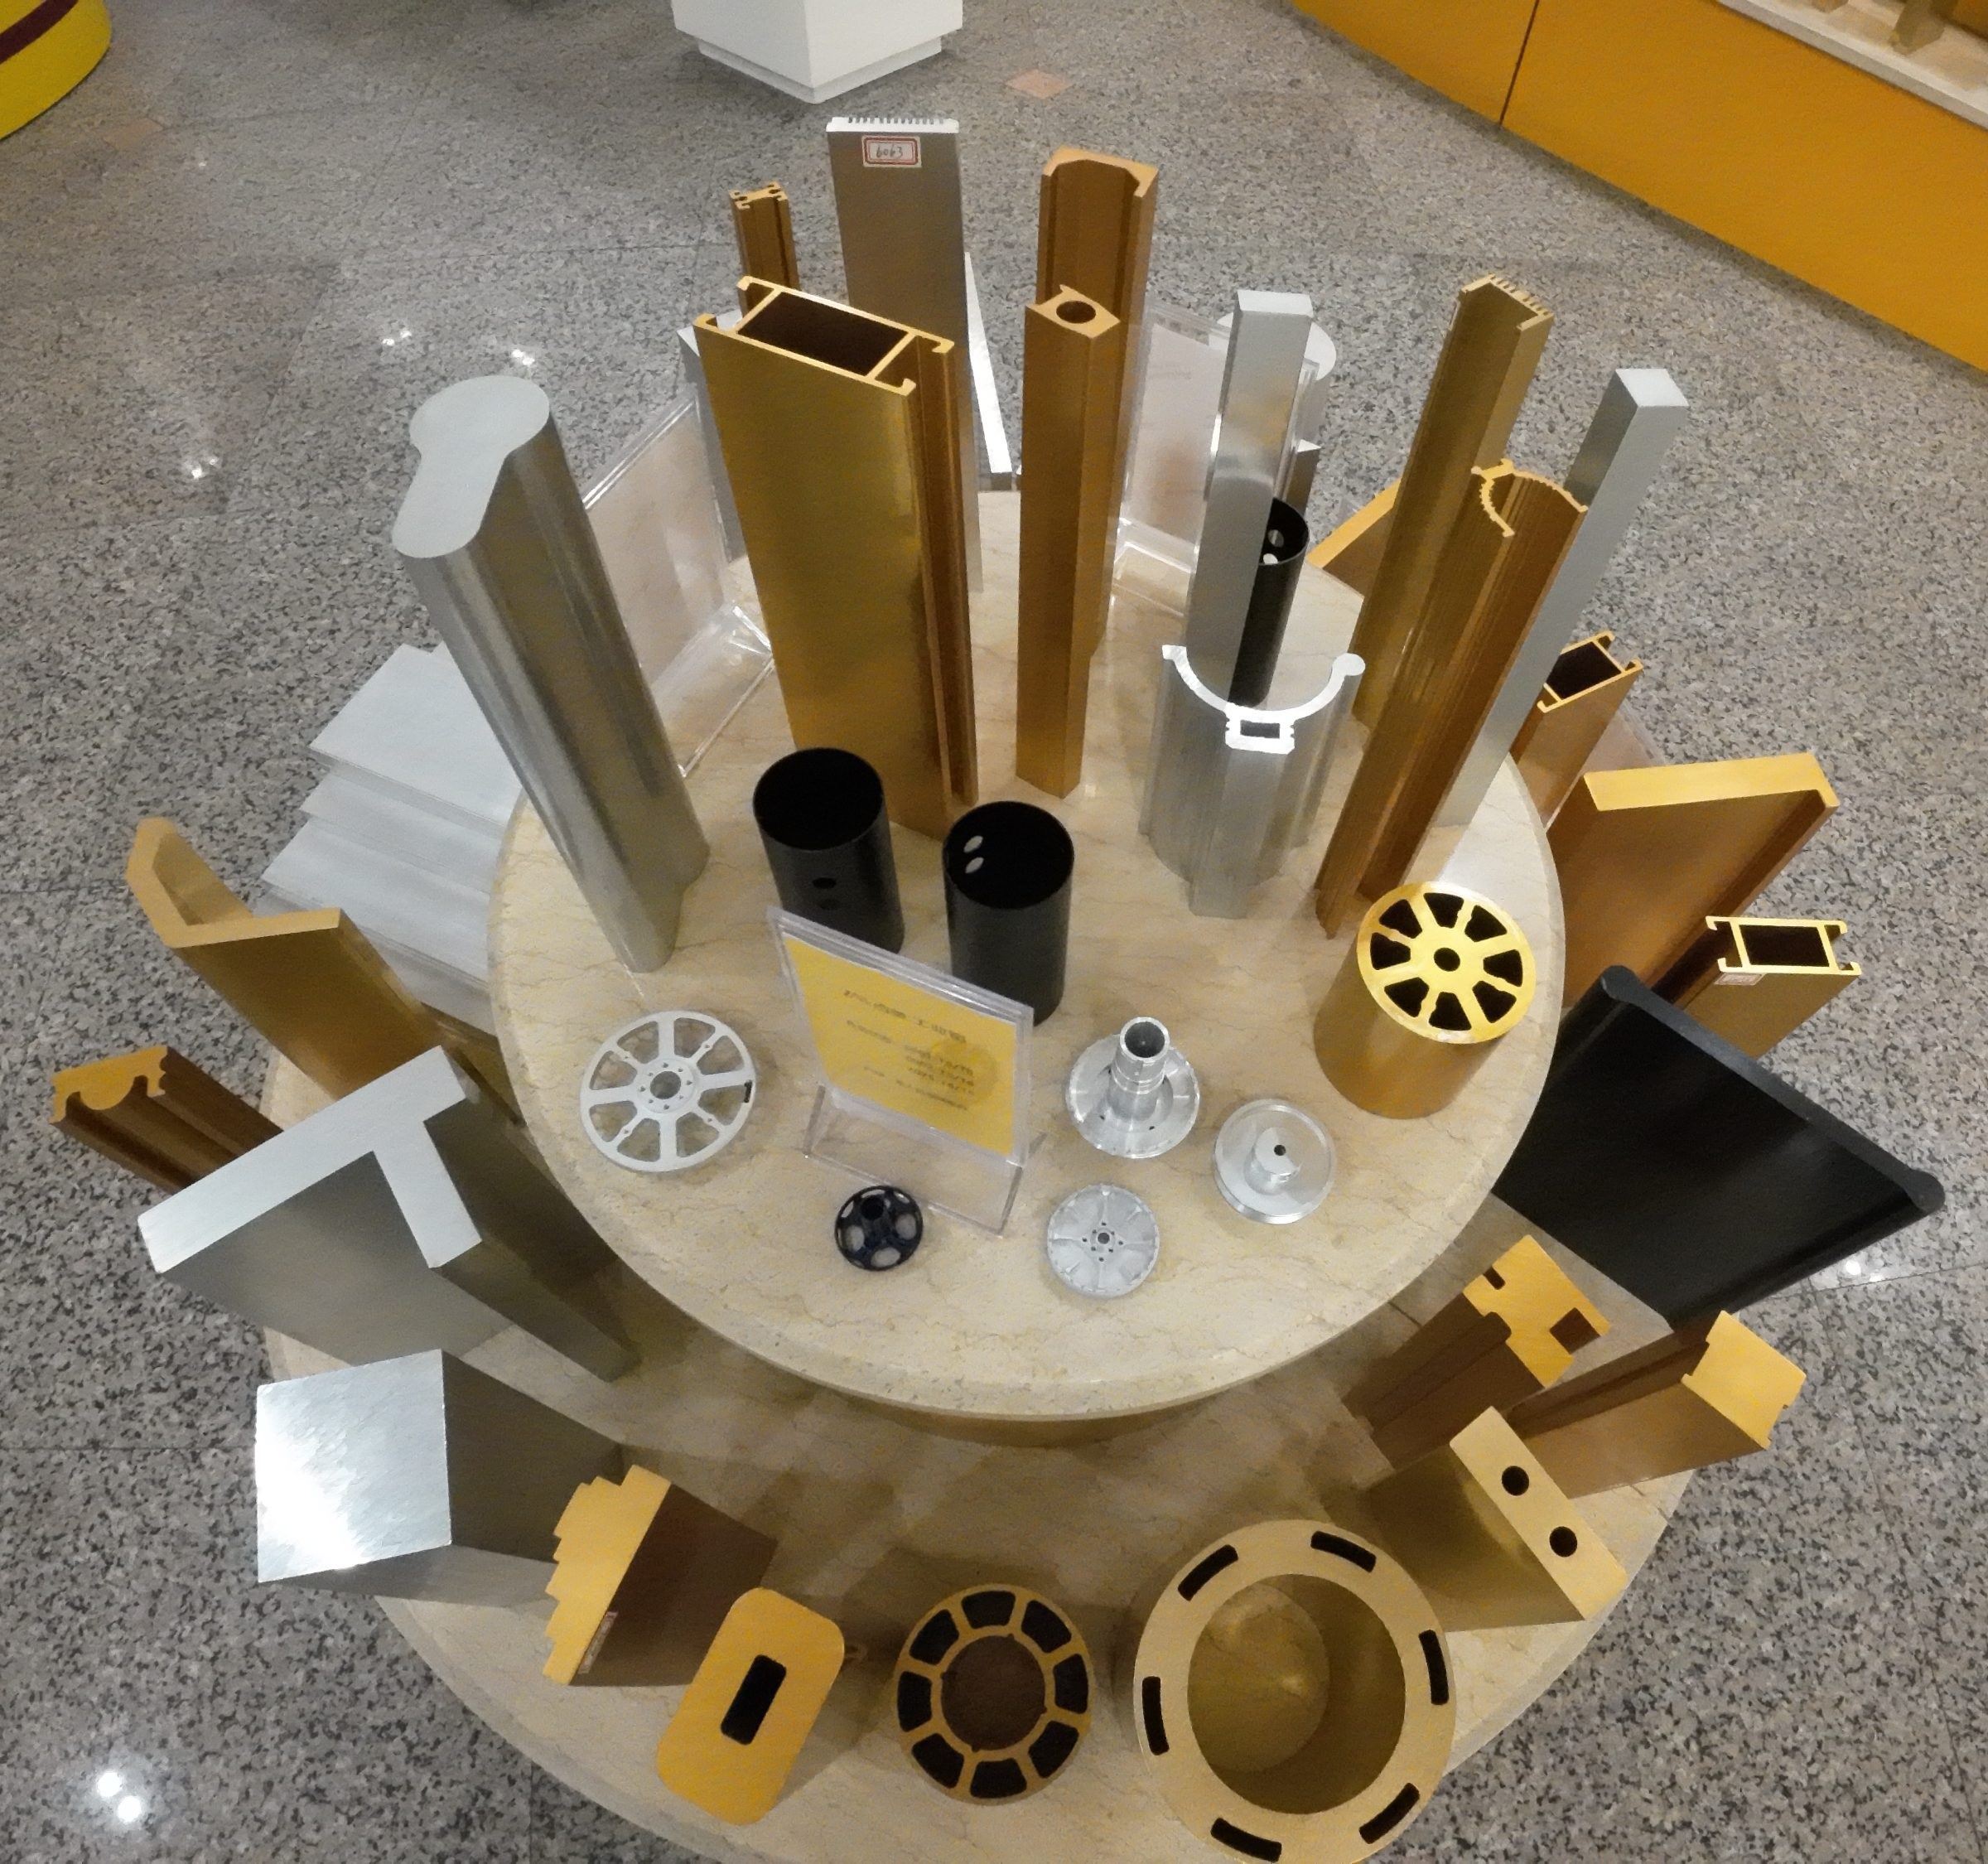
No | ID | Name | mass | sigma | x | y | x-LC | y-LC | Iyy | Ixx | Ixy | Ixx0 | Iyy0 | Ixy0 | theta | Imin | Imax | rmin | rmax
1. | 15 | FreeOut | 9.30 | 1.00 | 1.98 | 2.00 | 1.98 | 3.00 | 48.26 | 48.98 | 36.92 | 11.62 | 11.78 | 0.00 | 0.00 | 11.61 | 11.78 | 1.12 | 1.13
2. | 16 | FreeIn | 3.02 | 1.00 | 0.97 | 1.00 | 1.97 | 3.00 | 3.53 | 3.81 | 2.92 | 0.70 | 0.78 | 0.00 | 0.00 | 0.70 | 0.78 | 0.48 | 0.51
3. | 18 | FreeRect | 0.24 | 1.00 | 0.30 | 0.20 | 3.00 | 3.00 | 0.03 | 0.01 | 0.01 | 0.25 | 0.00 | 0.00 | 0.00 | 0.00 | 0.01 | 0.12 | 0.17
 |  | All | 12.56 |  |  |  | 2.00 | 3.00 | 62.82 | 125.65 | 75.39 | 12.56 | 12.56 | 0.00 | 0.00 | 12.56 | 12.56 | 1.00 | 1.00
No | ID | Name | areaa | perim | x | y | x-P | y-P | Iyy | Ixx | Ixy | Ixx0 | Iyy0 | Ixy0 | theta | Imin | Imax | rmin | rmax
1. | 8 | Free0 | 8.64 | 34.56 | 3.00 | 3.00 | 3.00 | 3.00 | 110.67 | 110.67 | 77.74 | 32.93 | 32.93 | 0.00 | - 32.70 | 32.93 | 32.93 | 1.95 | 1.95
2. | 14 | Free1 | 14.26 | 49.59 | 3.00 | 3.00 | 3.00 | 3.00 | 167.58 | 167.57 | 128.36 | 39.21 | 39.21 | 0.00 | 0.01 | 39.21 | 39.21 | 1.66 | 1.66
3. | 23 | Free2 | 17.45 | 60.61 | 3.00 | 3.00 | 3.00 | 3.00 | 200.39 | 200.37 | 157.01 | 43.38 | 43.37 | 0.00 | 0.03 | 43.37 | 43.38 | 1.58 | 1.58
4. | 29 | Free3 | 17.61 | 58.19 | 3.00 | 3.00 | 3.00 | 3.00 | 202.36 | 202.34 | 158.52 | 43.83 | 43.83 | 0.00 | 0.04 | 43.83 | 43.83 | 1.58 | 1.58
5. | 39 | Free4 | 17.86 | 58.65 | 3.00 | 3.00 | 3.00 | 3.00 | 204.94 | 204.93 | 160.69 | 44.25 | 44.24 | 0.00 | 0.02 | 44.24 | 44.25 | 1.57 | 1.57
6. | 9 | FreeCyl | 5.08 | 10.08 | 1.00 | 2.27 | 1.00 | 2.11 | 6.02 | 31.90 | 11.50 | 0.94 | 5.85 | 0.00 | - 90.00 | 0.94 | 5.85 | 0.43 | 1.07
7. | 5 | FreeB | 6.42 | 27.73 | 3.04 | 2.27 | 2.95 | 2.34 | 76.92 | 45.23 | 44.00 | 17.41 | 12.28 | - 0.28 | - 3.10 | 12.26 | 17.43 | 1.38 | 1.65
8. | 6 | FreeT | 5.96 | 20.32 | 4.70 | 1.84 | 4.38 | 1.93 | 158.80 | 22.89 | 48.08 | 26.82 | 2.77 | - 3.44 | - 7.99 | 2.29 | 27.31 | 0.62 | 2.14
9. | 32 | FreeWheel | 17.23 | 66.19 | 3.00 | 3.00 | 3.00 | 3.00 | 199.05 | 199.04 | 155.04 | 44.01 | 44.00 | 0.00 | 0.02 | 44.00 | 44.01 | 1.60 | 1.60
 |  | All

Slide 3
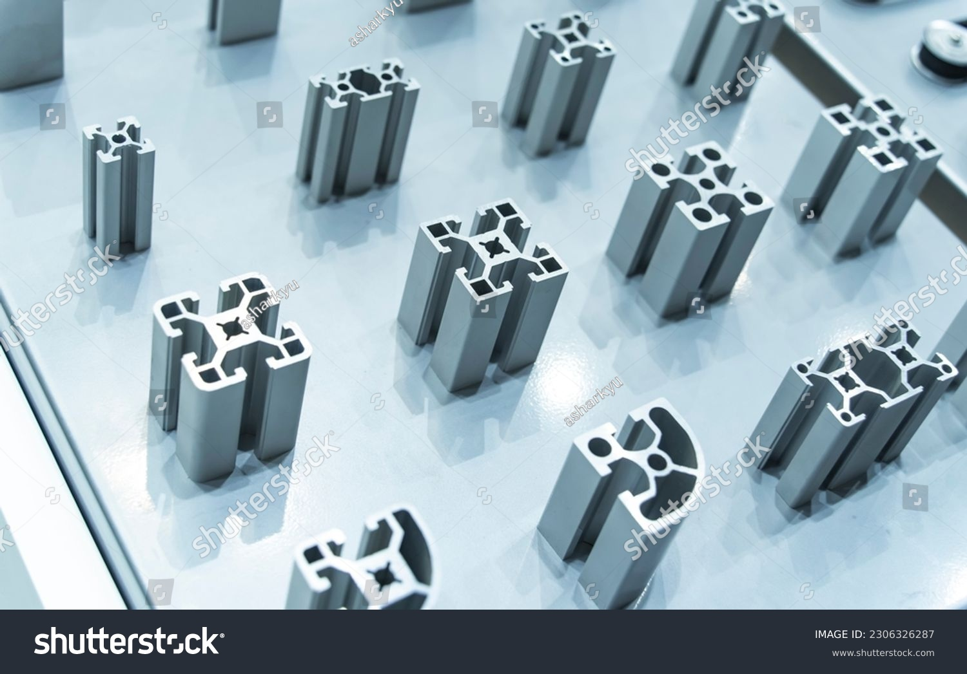
id:18/18
name: Alu0
Area: 9.00
Perim: 12.00
No | ID | Name | area | perim | x | y | x-LC | y-LC | Iyy | Ixx | Ixy | Ixx0 | Iyy0 | Ixy0 | theta | Imin | Imax | Rmin | rmax
1. | 18 | Alu0 | 9.00 | 12.00 | 1.50 | 1.50 | 1.50 | 1.50 | 27.00 | 27.00 | 20.25 | 6.75 | 6.75 | 0.00 | - 45.00 | 6.75 | 6.75 | 0.87 | 0.87
2. | 27 | Alu1 | 8.99 | 11.79 | 1.50 | 1.50 | 1.50 | 1.50 | 26.94 | 26.94 | 20.22 | 6.72 | 6.72 | 0.00 | 45.00 | 6.72 | 6.72 | 0.86 | 0.86
3. | 36 | Alu2 | 8.20 | 18.07 | 1.50 | 1.50 | 1.50 | 1.50 | 24.12 | 24.12 | 18.45 | 5.67 | 5.67 | 0.00 | - 55.90 | 5.67 | 5.67 | 0.83 | 0.83
4. | 56 | Alu3 | 5.64 | 28.12 | 1.50 | 1.50 | 1.50 | 1.50 | 16.92 | 16.92 | 12.69 | 4.22 | 4.22 | 0.00 | - 54.14 | 4.22 | 4.22 | 0.87 | 0.87
5. | 57 | Alu4 | 5.01 | 30.94 | 1.50 | 1.50 | 1.50 | 1.50 | 15.45 | 15.45 | 11.26 | 4.19 | 4.19 | 0.00 | - 54.17 | 4.19 | 4.19 | 0.92 | 0.92
6. | 52 | ToolT | 0.69 | 3.71 | 0.50 | 0.55 | 0.50 | 0.52 | 0.21 | 0.26 | 0.19 | 0.04 | 0.05 | 0.00 | 90.00 | 0.04 | 0.05 | 0.23 | 0.27
7. | 16 | Tool4C | 0.95 | 3.79 | 0.50 | 0.50 | 0.50 | 0.50 | 0.31 | 0.31 | 0.24 | 0.07 | 0.07 | 0.00 | 45.00 | 0.07 | 0.07 | 0.28 | 0.28
 |  | All
No | ID | Name | Area | Perim | xA | yA | xP | yP | Iyy | Ixx
1. | 18 | Alu0 | 9.00 | 12.00 | 1.50 | 1.50 | 1.50 | 1.50 | 27.00 | 27.00 | 20.25 | 6.75 | 6.75 | 0.00 | - 45.00 | 6.75 | 6.75 | 0.87 | 0.87
2. | 27 | Alu1 | 8.99 | 11.79 | 1.50 | 1.50 | 1.50 | 1.50 | 26.94 | 26.94 | 20.22 | 6.72 | 6.72 | 0.00 | 45.00 | 6.72 | 6.72 | 0.86 | 0.86
3. | 36 | Alu2 | 8.20 | 18.07 | 1.50 | 1.50 | 1.50 | 1.50 | 24.12 | 24.12 | 18.45 | 5.67 | 5.67 | 0.00 | - 55.90 | 5.67 | 5.67 | 0.83 | 0.83
4. | 56 | Alu3 | 5.64 | 28.12 | 1.50 | 1.50 | 1.50 | 1.50 | 16.92 | 16.92 | 12.69 | 4.22 | 4.22 | 0.00 | - 54.14 | 4.22 | 4.22 | 0.87 | 0.87
5. | 57 | Alu4 | 5.01 | 30.94 | 1.50 | 1.50 | 1.50 | 1.50 | 15.45 | 15.45 | 11.26 | 4.19 | 4.19 | 0.00 | - 54.17 | 4.19 | 4.19 | 0.92 | 0.92
6. | 52 | ToolT | 0.69 | 3.71 | 0.50 | 0.55 | 0.50 | 0.52 | 0.21 | 0.26 | 0.19 | 0.04 | 0.05 | 0.00 | 90.00 | 0.04 | 0.05 | 0.23 | 0.27
7. | 16 | Tool4C | 0.95 | 3.79 | 0.50 | 0.50 | 0.50 | 0.50 | 0.31 | 0.31 | 0.24 | 0.07 | 0.07 | 0.00 | 45.00 | 0.07 | 0.07 | 0.28 | 0.28
8. | 10 | FreefCyll | 5.58 | 11.08 | 2.55 | 1.00 | 2.37 | 1.00 | 44.75 | 6.56 | 14.22 | 8.51 | 0.98 | 0.00 | 0.00 | 0.98 | 8.51 | 0.42 | 1.24
 |  | All
id:27/27
name: Alu1
Area: 8.99
Perim: 11.79
id:36/36
name: Alu2
Area: 8.20
Perim: 18.07
id:56/56
name: Alu3
Area: 5.64
Perim: 28.12
id:57/57
name: Alu4
Area: 5.01
Perim: 30.94

