Slide 1
No | ID | Name | area | perim | x | y | x-LC | y-LC | Iyy | Ixx | Ixy | Ixx0 | Iyy0 | Ixy0 | theta | Imin | Imax | rmin | rmax
1. | 3 | FreeDeep | 24.13 | 46.61 | 3.77 | 3.18 | 3.81 | 2.98 | 433.69 | 304.48 | 294.82 | 89.95 | 60.07 | 4.97 | 9.21 | 59.27 | 90.76 | 1.57 | 1.94
 |  | All
id:10/10
name: FreeMini
Area: -13.65
Perim: 86.40

Slide 2
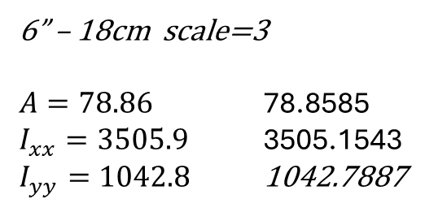
ArcelorMittal - Grooved Rails - 62R2 (Np4aS)
id:2/2
name: 62R2-6
Area: 78.86
Perim: 92.08
id:15/15
name: MRS125-6
Area: 159.59
Perim: 79.41
id:17/17
name: 60E2-5
Area: 76.47
Perim: 67.57
6” – 18cm scale=3
$A=78.86$ 78.8585
$I_{xx}=3505.9$ 3505.1543
$I_{yy}=1042.8$ 1042.7887
Picture in scale 1” ~ 3cm M=3
No | ID | Name | area | perim | x | y | x-LC | y-LC | Iyy | Ixx | Ixy | Ixx0 | Iyy0 | Ixy0 | theta | Imin | Imax | rmin | rmax
1. | 2 | 62R2-6 | 78.86 | 92.08 | 9.89 | 9.68 | 9.80 | 7.73 | 8,756.45 | 10,891.88 | 7,900.86 | 1,042.78 | 3,505.13 | 352.42 | 82.01 | 993.34 | 3,554.58 | 3.55 | 6.71
2. | 17 | 60E2-5 | 76.47 | 67.57 | 7.50 | 8.07 | 7.50 | 6.65 | 4,812.98 | 7,998.56 | 4,627.49 | 510.67 | 3,021.55 | 0.11 | 90.00 | 510.67 | 3,021.55 | 2.58 | 6.29
3. | 15 | MRS125-6 | 159.59 | 79.41 | 9.00 | 8.87 | 9.00 | 7.70 | 14,999.25 | 18,650.62 | 12,744.80 | 2,072.26 | 6,085.52 | 0.04 | 90.00 | 2,072.26 | 6,085.52 | 3.60 | 6.18
 |  | All
Non4 sn | ID | Name | area | perim | x | y | x-LC | y-LC | Ixx0 | Iyy0 | Ixy0 | theta | Imin | Imax | rmin | rmax
1. | 2 | 62R2-6 | 78.86 | 92.08 | 9.89 | 9.68 | 9.80 | 7.73 | 1,042.78 | 3,505.13 | 352.42 | 82.01 | 993.34 | 3,554.58 | 3.55 | 6.71
2. | 17 | 60E2-5 | 76.47 | 67.57 | 7.50 | 8.07 | 7.50 | 6.65 | 510.67 | 3,021.55 | 0.11 | 90.00 | 510.67 | 3,021.55 | 2.58 | 6.29
3. | 15 | MRS125-6 | 159.59 | 79.41 | 9.00 | 8.87 | 9.00 | 7.70 | 2,072.26 | 6,085.52 | 0.04 | 90.00 | 2,072.26 | 6,085.52 | 3.60 | 6.18
 |  | AM,….. | 160.25 |  |  |  |  |  | 2,250.00 | 6,225.00
 |  | Gantrail | 159.80 |  |  |  |  |  | 2,079.00 | 6,093.00

Slide 3
id:15/15
name: MRS125-6
Area: 159.59
Perim: 79.41
id:2/2
name: 62R2-6
Area: 78.86
Perim: 92.08
ArcelorMittal - Grooved Rails - 62R2 (Np4aS)
id:17/17
name: 60E2-5
Area: 76.47
Perim: 67.57
Full scale 1” ~ 2.54cm
6” – 18cm scale=3
$A=78.86$ 78.8585
$I_{xx}=3505.9$ 3505.1543
$I_{yy}=1042.8$ 1042.7887
MRS125 relative error $ε_{x}=\frac{2250−2079}{2079}$ 8.22% $ε_{y}=\frac{6225−6093}{6093}$ 2.16%
No | ID | Name | area | perim | x | y | x-LC | y-LC | Iyy | Ixx | Ixy | Ixx0 | Iyy0 | Ixy0 | theta | Imin | Imax | rmin | rmax
1. | 2 | 62R2-6 | 78.86 | 92.08 | 9.89 | 9.68 | 9.80 | 7.73 | 8,756.45 | 10,891.88 | 7,900.86 | 1,042.78 | 3,505.13 | 352.42 | 82.01 | 993.34 | 3,554.58 | 3.55 | 6.71
2. | 17 | 60E2-5 | 76.47 | 67.57 | 7.50 | 8.07 | 7.50 | 6.65 | 4,812.98 | 7,998.56 | 4,627.49 | 510.67 | 3,021.55 | 0.11 | 90.00 | 510.67 | 3,021.55 | 2.58 | 6.29
3. | 15 | MRS125-6 | 159.59 | 79.41 | 9.00 | 8.87 | 9.00 | 7.70 | 14,999.25 | 18,650.62 | 12,744.80 | 2,072.26 | 6,085.52 | 0.04 | 90.00 | 2,072.26 | 6,085.52 | 3.60 | 6.18
 |  | All
Non4 sn | ID | Name | area | perim | x | y | x-LC | y-LC | Ixx0 | Iyy0 | Ixy0 | theta | Imin | Imax | rmin | rmax
1. | 2 | 62R2-6 | 78.86 | 92.08 | 9.89 | 9.68 | 9.80 | 7.73 | 1,042.78 | 3,505.13 | 352.42 | 82.01 | 993.34 | 3,554.58 | 3.55 | 6.71
2. | 17 | 60E2-5 | 76.47 | 67.57 | 7.50 | 8.07 | 7.50 | 6.65 | 510.67 | 3,021.55 | 0.11 | 90.00 | 510.67 | 3,021.55 | 2.58 | 6.29
3. | 15 | MRS125-6 | 159.59 | 79.41 | 9.00 | 8.87 | 9.00 | 7.70 | 2,072.26 | 6,085.52 | 0.04 | 90.00 | 2,072.26 | 6,085.52 | 3.60 | 6.18
 |  | AM,….. | 160.25 |  |  |  |  |  | 2,250.00 | 6,225.00
 |  | Gantrail | 159.80 |  |  |  |  |  | 2,079.00 | 6,093.00

Slide 4
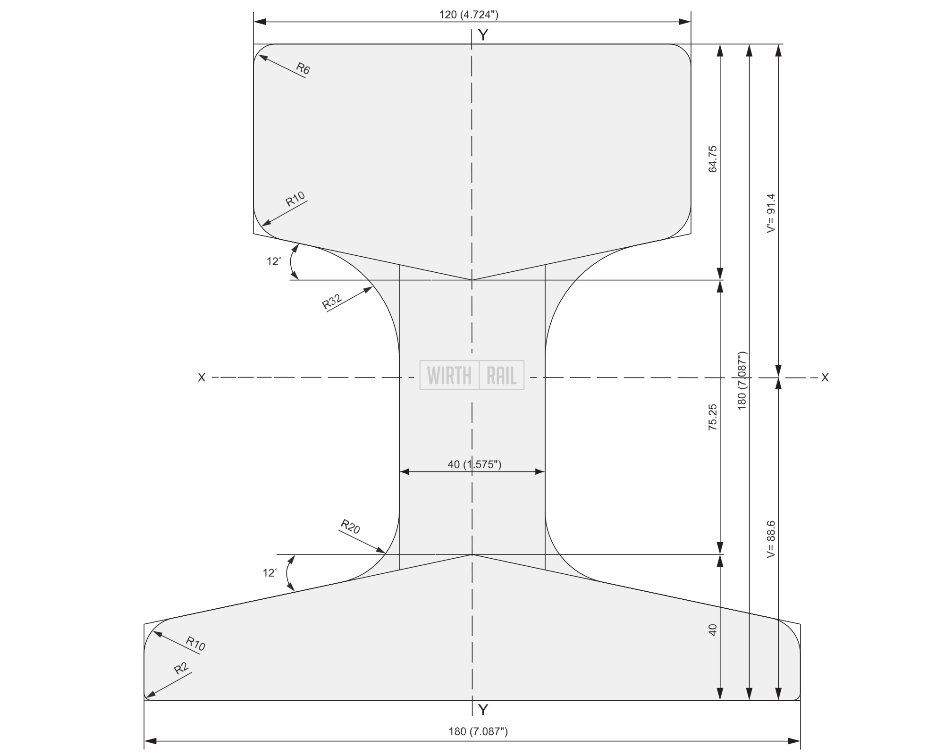
Link MRS125 - Wirth Rail
No | ID | Name | area | perim | x | y | x-LC | y-LC | Iyy | Ixx | Ixy | Ixx0 | Iyy0 | Ixy0 | theta | Imin | Imax | rmin | rmax
1. | 3 | FreeDeep | 24.13 | 46.61 | 3.77 | 3.18 | 3.81 | 2.98 | 433.69 | 304.48 | 294.82 | 89.95 | 60.07 | 4.97 | 9.21 | 59.27 | 90.76 | 1.57 | 1.94
 |  | All

Slide 5
No | ID | Name | area | perim | x | y | x-LC | y-LC | Iyy | Ixx | Ixy | Ixx0 | Iyy0 | Ixy0 | theta | Imin | Imax | rmin | rmax
1. | 3 | FreeDeep | 24.13 | 46.61 | 3.77 | 3.18 | 3.81 | 2.98 | 433.69 | 304.48 | 294.82 | 89.95 | 60.07 | 4.97 | 9.21 | 59.27 | 90.76 | 1.57 | 1.94
 |  | All
Scale 6.52” – 18cm M=2.76074
AM MRS125 – ArcelorMittal
Gantrail link: Resources - Gantry Rail
A=160.25 cm2 159.6 159.8
Ixx=6225.0 6085.2 6093
Iyy=2250.0 2072.2 2079

Slide 6
No | ID | Name | area | perim | x | y | x-LC | y-LC | Iyy | Ixx | Ixy | Ixx0 | Iyy0 | Ixy0 | theta | Imin | Imax | rmin | rmax
1. | 3 | FreeDeep | 24.13 | 46.61 | 3.77 | 3.18 | 3.81 | 2.98 | 433.69 | 304.48 | 294.82 | 89.95 | 60.07 | 4.97 | 9.21 | 59.27 | 90.76 | 1.57 | 1.94
 |  | All
id:10/10
name: FreeMini
Area: -13.65
Perim: 86.40

Slide 7
cc
ccc
ccc
No | ID | Name | area | perim | x | y | x-LC | y-LC | Iyy | Ixx | Ixy | Ixx0 | Iyy0 | Ixy0 | theta | Imin | Imax | rmin | rmax
1. | 3 | FreeDeep | 24.13 | 46.61 | 3.77 | 3.18 | 3.81 | 2.98 | 433.69 | 304.48 | 294.82 | 89.95 | 60.07 | 4.97 | 9.21 | 59.27 | 90.76 | 1.57 | 1.94
 |  | All

Slide 8
cc
ccc
ccc
ccc
ccc
No | ID | Name | area | perim | x | y | x-LC | y-LC | Iyy | Ixx | Ixy | Ixx0 | Iyy0 | Ixy0 | theta | Imin | Imax | rmin | rmax
1. | 3 | FreeDeep | 24.13 | 46.61 | 3.77 | 3.18 | 3.81 | 2.98 | 433.69 | 304.48 | 294.82 | 89.95 | 60.07 | 4.97 | 9.21 | 59.27 | 90.76 | 1.57 | 1.94
 |  | All

Slide 9

cc
ccc
ccc
ccc
No | ID | Name | area | perim | x | y | x-LC | y-LC | Iyy | Ixx | Ixy | Ixx0 | Iyy0 | Ixy0 | theta | Imin | Imax | rmin | rmax
1. | 3 | FreeDeep | 24.13 | 46.61 | 3.77 | 3.18 | 3.81 | 2.98 | 433.69 | 304.48 | 294.82 | 89.95 | 60.07 | 4.97 | 9.21 | 59.27 | 90.76 | 1.57 | 1.94
 |  | All

Slide 10
c
No | ID | Name | area | perim | x | y | x-LC | y-LC | Iyy | Ixx | Ixy | Ixx0 | Iyy0 | Ixy0 | theta | Imin | Imax | rmin | rmax
1. | 3 | FreeDeep | 24.13 | 46.61 | 3.77 | 3.18 | 3.81 | 2.98 | 433.69 | 304.48 | 294.82 | 89.95 | 60.07 | 4.97 | 9.21 | 59.27 | 90.76 | 1.57 | 1.94
 |  | All
id:10/10
name: FreeMini
Area: -13.65
Perim: 86.40
id:235/235
name: Free60E2
Area: - 76.43
Perim: 67.55
Iy=3016
Iy=510.4
Datasheet rail 60e2 moments of inertia - Google pretraživanje
A=76.48
Ix=3021.5
Iy=510.5
PDF Link 60E2 - Wirth Rail

Slide 11
id:10/10
name: 62R2-In
Area: 12.23
Perim: 36.27
ArcelorMittal - Grooved Rails - 62R2 (Np4aS)
No | ID | Name | area | perim | x | y | x-LC | y-LC | Iyy | Ixx | Ixy | Ixx0 | Iyy0 | Ixy0 | theta | Imin | Imax | rmin | rmax
1. | 12 | FreeRect | 13.00 | 17.00 | 3.25 | 1.00 | 3.25 | 1.00 | 183.08 | 17.33 | 42.25 | 45.77 | 4.33 | 0.00 | 0.00 | 4.33 | 45.77 | 0.58 | 1.88
2. | 11 | FreeATP | - 2.26 | 35.88 | 6.47 | 1.23 | 3.32 | 0.89 | - 75.38 | - 3.82 | - 15.81 | 18.94 | - 0.40 | 2.16 | 6.30 | - 0.64 | 19.18 | 0.53 | NaN
3. | 20 | FreeATPx | 5.88 | 35.75 | 3.49 | 0.97 | 3.32 | 0.89 | 86.12 | 7.10 | 20.83 | 14.44 | 1.60 | 0.95 | 4.23 | 1.53 | 14.51 | 0.51 | 1.57
4. | 3 | FreeLogo | 7.13 | 52.88 | 3.05 | 0.94 | 3.30 | 0.99 | 96.97 | 9.04 | 19.38 | 30.71 | 2.69 | - 1.13 | - 2.31 | 2.64 | 30.76 | 0.61 | 2.08
5. | 13 | FreeT | 0.25 | 3.47 | 0.36 | 0.60 | 0.35 | 0.60 | 0.04 | 0.11 | 0.06 | 0.01 | 0.02 | 0.00 | 73.53 | 0.01 | 0.02 | 0.15 | 0.29
6. | 16 | FreeO | 0.40 | 5.04 | 0.48 | 0.48 | 0.48 | 0.48 | 0.13 | 0.12 | 0.10 | 0.03 | 0.03 | 0.00 | 41.74 | 0.03 | 0.04 | 0.27 | 0.31
7. | 14 | FreeU | 0.35 | 4.66 | 0.44 | 0.44 | 0.45 | 0.47 | 0.10 | 0.09 | 0.07 | 0.03 | 0.03 | 0.00 | 30.84 | 0.02 | 0.04 | 0.26 | 0.32
8. | 15 | FreeR | 0.42 | 5.35 | 0.46 | 0.49 | 0.47 | 0.47 | 0.12 | 0.13 | 0.10 | 0.03 | 0.03 | 0.01 | 49.77 | 0.02 | 0.03 | 0.24 | 0.29
9. | 18 | FreeRTM | 0.05 | 0.93 | 0.14 | 0.09 | 0.14 | 0.09 | 0.00 | 0.00 | 0.00 | 0.00 | 0.00 | 0.00 | 0.00 | 0.00 | 0.00 | 0.05 | 0.08
10. | 17 | FreeTM | 0.01 | 1.00 | 0.11 | 0.05 | 0.10 | 0.05 | 0.00 | 0.00 | 0.00 | 0.00 | 0.00 | 0.00 | - 3.36 | 0.00 | 0.00 | 0.03 | 0.06
 |  | All
id:468/468
name: 62R2
Area: 78.86
Perim: 92.08
6” – 18cm scale=3
$A=78.86$ 78.8585
$I_{xx}=3505.9$ 3505.1543
$I_{yy}=1042.8$ 1042.7887

Slide 12
100ARA-A shape 27,28
A= 9.84 In ²
I= 48.94 In ⁴
5.5” – 13.97cm M=2.54
Noc | ID | Name | area | perim | x | y | x-LC | y-LC | Iyy | Ixx | Ixy | Ixx0 | Iyy0 | Ixy0 | theta | Imin | Imax | rmin | rmax
1. | 2 | 62R2-In | 12.23 | 36.27 | 3.90 | 3.81 | 3.86 | 3.05 | 210.78 | 262.18 | 190.18 | 25.10 | 84.37 | 8.48 | 82.01 | 23.91 | 85.56 | 1.40 | 2.64
2. | 11 | 60R2-In | 11.80 | 35.65 | 3.81 | 3.68 | 3.84 | 2.97 | 193.53 | 238.85 | 170.60 | 22.14 | 79.33 | 5.25 | 84.80 | 21.66 | 79.81 | 1.35 | 2.60
3. | 12 | 90ARA | - 8.76 | 22.95 | 2.57 | 2.54 | 2.57 | 2.23 | - 65.11 | - 94.25 | - 57.13 | - 7.42 | - 37.67 | 0.00 | 0.00 | - 37.67 | - 7.42 | 2.07 | 0.92
 |  | All
19.Pdf link datasheet on Wirth Rail
100ARAA - Wirth Rail

