Slide 1
id:18/18
name: Alu0
Area: 36.00
Perim: 24.00
No | ID | Name | Area | Perim | xA | yA | xP | yP | Iyy | Ixx
1. | 18 | Alu0 | 36 | 24 | 3 | 3 | 3 | 3 | 432 | 432
2. | 27 | Alu1 | 35.9463 | 23.5709 | 3 | 3 | 3 | 3 | 431.052 | 431.052
3. | 36 | Alu2 | 32.8051 | 36.1377 | 3 | 3 | 3 | 3 | 385.967 | 385.967
4. | 56 | Alu3 | 22.5644 | 56.2338 | 3 | 3 | 3 | 3 | 270.662 | 270.662
5. | 57 | Alu4 | 20.0201 | 61.8889 | 3 | 3 | 3 | 3 | 247.247 | 247.247
6. | 52 | ToolT | 2.76017 | 7.42402 | 1 | 0.896036 | 1 | 0.961349 | 3.36385 | 2.99519
7. | 16 | Tool4C | 3.80367 | 7.57086 | 1 | 1 | 1 | 1 | 4.97927 | 4.97927
id:27/27
name: Alu1
Area: 35.95
Perim: 23.57
id:36/36
name: Alu2
Area: 32.81
Perim: 36.14
id:57/57
name: Alu4
Area: 20.02
Perim: 61.89
id:56/56
name: Alu3
Area: 22.56
Perim: 56.23
No | ID | Name | area | perim | x | y | x-LC | y-LC | Iyy | Ixx | Ixy | Ixx0 | Iyy0 | Ixy0 | theta | Imin | Imax | Rmin | rmax
1. | 18 | Alu0 | 36.00 | 24.00 | 3.00 | 3.00 | 3.00 | 3.00 | 432.00 | 432.00 | 324.00 | 108.00 | 108.00 | 0.00 | 45.00 | 108.00 | 108.00 | 1.73 | 1.73
2. | 27 | Alu1 | 35.95 | 23.57 | 3.00 | 3.00 | 3.00 | 3.00 | 431.05 | 431.05 | 323.52 | 107.53 | 107.53 | 0.00 | - 45.00 | 107.53 | 107.53 | 1.73 | 1.73
3. | 36 | Alu2 | 32.81 | 36.14 | 3.00 | 3.00 | 3.00 | 3.00 | 385.97 | 385.97 | 295.25 | 90.72 | 90.72 | 0.00 | - 45.00 | 90.72 | 90.72 | 1.66 | 1.66
4. | 56 | Alu3 | 22.56 | 56.23 | 3.00 | 3.00 | 3.00 | 3.00 | 270.66 | 270.66 | 203.08 | 67.58 | 67.58 | 0.00 | - 45.00 | 67.58 | 67.58 | 1.73 | 1.73
5. | 57 | Alu4 | 20.02 | 61.89 | 3.00 | 3.00 | 3.00 | 3.00 | 247.25 | 247.25 | 180.18 | 67.07 | 67.07 | 0.00 | - 45.00 | 67.07 | 67.07 | 1.83 | 1.83
6. | 52 | ToolT | 2.76 | 7.42 | 1.00 | 1.10 | 1.00 | 1.04 | 3.36 | 4.14 | 3.05 | 0.60 | 0.78 | 0.00 | 90.00 | 0.60 | 0.78 | 0.47 | 0.53
7. | 16 | Tool4C | 3.80 | 7.57 | 1.00 | 1.00 | 1.00 | 1.00 | 4.98 | 4.98 | 3.80 | 1.18 | 1.18 | 0.00 | - 45.00 | 1.18 | 1.18 | 0.56 | 0.56
 |  | All

Slide 2
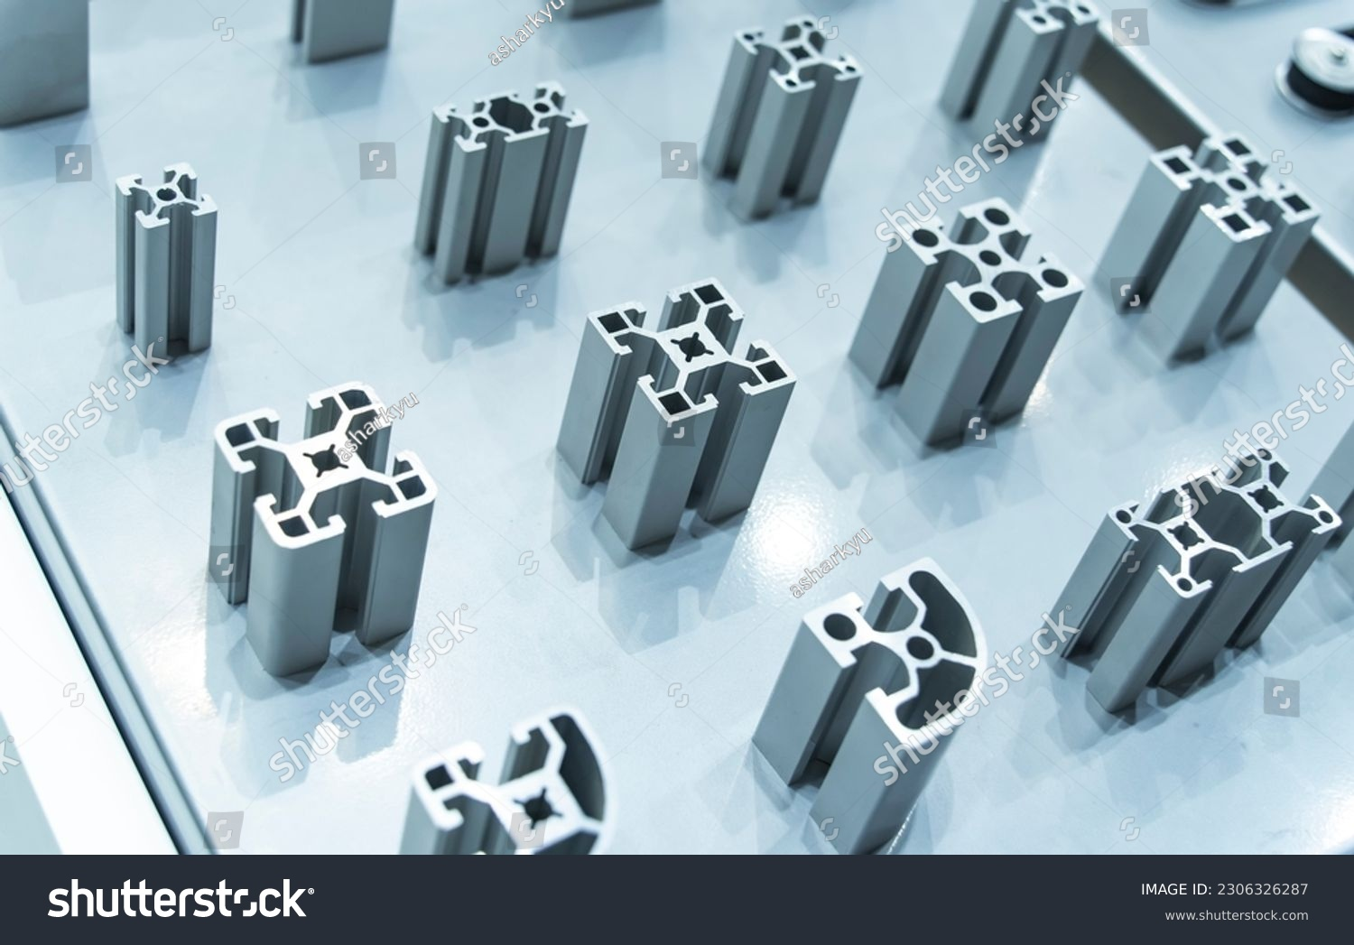

id:13/13
name: Alu4
Area: 20.02
Perim: 61.89
id:2/2
name: Alu6
Area: 19.62
Perim: 62.00
No | ID | Name | area | perim | x | y | x-LC | y-LC | Iyy | Ixx | Ixy | Ixx0 | Iyy0 | Ixy0 | theta | Imin | Imax | Rmin | rmax
1. | 13 | Alu4 | 20.02 | 61.89 | 3.00 | 3.00 | 3.00 | 3.00 | 247.25 | 247.25 | 180.18 | 67.07 | 67.07 | 0.00 | - 45.00 | 67.07 | 67.07 | 1.83 | 1.83
2. | 2 | Alu6 | 19.62 | 62.00 | 3.00 | 3.00 | 3.00 | 3.00 | 243.91 | 243.91 | 176.58 | 67.33 | 67.33 | 0.00 | - 45.00 | 67.33 | 67.33 | 1.85 | 1.85
 |  | All

Slide 3

Initial Condition
$a=\frac{9}{2}$ $b=\frac{9}{2}$ $r=\frac{b}{18}1$ $R=\frac{b}{6}$
Calculation Circle Holes
$a_{0}=b^{2}$
$a_{1}=a_{0}−R^{2}π$
$a_{2}=a_{1}−8r^{2}π$
$p_{0}=4b$
$p_{1}=p_{0}+2Rπ$
$p_{2}=p_{1}+16rπ$
Calculation Rect Holes
$A_{0}=a^{2}$
$A_{1}=A_{0}−{\left(\frac{a}{3}\right)}^{2}$
$A_{2}=A_{1}−8{\left(\frac{a}{9}\right)}^{2}$
$P_{0}=4a$
$P_{1}=P_{0}+4\frac{a}{3}$
$P_{2}=P_{1}+32\frac{a}{9}$
No | ID | Name | Area | Perim | xA | yA | xP | yP | Iyy | Ixx
1. | 87 | Rect2 | 16.00 | 40.00 | 2.25 | 2.25
2. | 69 | Rect1 | 18.00 | 24.00 | 2.25 | 2.25
3. | 5 | Rect0 | 20.25 | 18.00 | 2.25 | 2.25
4. | 63 | RectC2 | 16.91 | 35.28 | 2.25 | 2.25
5. | 36 | RectC1 | 18.48 | 22.71 | 2.25 | 2.25
 |  | All
¸¸
AdoMath Results
𝑎 = 4.5
𝑏 = 4.5
𝑟 = 0.25
𝑅 = 0.75
𝑎_0 = 20.25
𝑎_1 = 18.4828541323557
𝑎_2 = 16.9120578055608
𝑝_0 = 18
𝑝_1 = 22.7123889803847
𝑝_2 = 35.2787595947439
𝐴_0 = 20.25
𝐴_1 = 18
𝐴_2 = 16
𝑃_0 = 18
𝑃_1 = 24
𝑃_2 = 40
Finished: 1/29/2024 11:02:07 AM
No | ID | Name | area | perim | x | y | x-LC | y-LC | Iyy | Ixx | Ixy | Ixx0 | Iyy0 | Ixy0 | theta | Imin | Imax | Rmin | rmax
1. | 5 | Rect0 | 20.25 | 18.00 | 2.25 | 2.25 | 2.25 | 2.25 | 136.69 | 136.69 | 102.52 | 34.17 | 34.17 | 0.00 | - 45.00 | 34.17 | 34.17 | 1.30 | 1.30
2. | 69 | Rect1 | 18.00 | 24.00 | 2.25 | 2.25 | 2.25 | 2.25 | 124.88 | 124.88 | 91.13 | 33.75 | 33.75 | 0.00 | 0.00 | 33.75 | 33.75 | 1.37 | 1.37
3. | 87 | Rect2 | 16.00 | 40.00 | 2.25 | 2.25 | 2.25 | 2.25 | 111.33 | 111.33 | 81.00 | 30.33 | 30.33 | 0.00 | - 45.00 | 30.33 | 30.33 | 1.38 | 1.38
4. | 36 | RectC1 | 18.48 | 22.71 | 2.25 | 2.25 | 2.25 | 2.25 | 127.49 | 127.49 | 93.57 | 33.92 | 33.92 | 0.00 | 45.00 | 33.92 | 33.92 | 1.35 | 1.35
5. | 63 | RectC2 | 16.91 | 35.28 | 2.25 | 2.25 | 2.25 | 2.25 | 116.87 | 116.87 | 85.62 | 31.25 | 31.25 | 0.00 | 45.00 | 31.25 | 31.25 | 1.36 | 1.36
 |  | All

Slide 4



Steiner Theorem : https://en.wikipedia.org/wiki/Parallel_axis_theorem
Correct results:
guest - AdoMath
Current User:guest
Upload status: compiling PPTX
Compiled by slides: 00:00:00.1406282
Start: 12/17/2024 2:39:32 PM / X9.pptx
Listed: X9.pptx Ind:4
AdoMath Results
𝑎 = 2
𝑏 = 3
𝐴_𝑅𝑒𝑐𝑡 = 6
𝑃_𝑅𝑒𝑐𝑡 = 10
𝑥̅_𝑅𝑒𝑐𝑡 = 1.5
𝑦̅_𝑅𝑒𝑐𝑡 = 1.5
𝐼_𝑦𝑦𝑅𝑒𝑐𝑡 = 18
𝑟 = 2
𝐴 = 0.858407346410208
𝑃 = 7.14159265358978
𝑥̅ = 1.55326412210849
𝑦̅ = 1.55326412210849
𝐼_𝑦𝑦 = 0.292036732051101
𝐴_𝐶𝑖𝑟 = 3.14159265358979
𝑃_𝐶𝑖𝑟 = 7.14159265358978
𝑥̅_𝐶𝑖𝑟 = 0.848826363156776
𝑦̅_𝐶𝑖𝑟 = 0.848826363156776
𝐼_𝑦𝑦𝐶𝑖𝑟 = 3.14159265358979
Finished: 12/17/2024 2:39:32 PM
Moments of Inertia - Reference Table | calcresource
$a=2$
$b=3$
$A_{Rect}=ab$
$P_{Rect}=2\left(a+b\right)$
${\overline{x}}_{Rect}=\frac{b}{2}$ // ${\overline{y}}_{Rect}=\frac{b}{2}$
$I_{yyRect}=a\frac{b^{3}}{3}$
$r=2$
$A=\left(1−\frac{π}{4}\right)r^{2}$
$P=\left(2+\frac{π}{2}\right)r$
$\overline{x}=\frac{2r}{3\left(4−π\right)}$ // $\overline{y}=\frac{2r}{3\left(4−π\right)}$
$I_{yy}=\left(1−\frac{5π}{16}\right)r^{4}$
$r=2$
$A_{Cir}=r^{2}\frac{π}{4}$
$P_{Cir}=\left(2+\frac{π}{2}\right)r$
${\overline{x}}_{Cir}=\frac{4r}{3π}$ // ${\overline{y}}_{Cir}=\frac{4r}{3π}$
$I_{yyCir}=r^{4}\frac{π}{16}$
No | ID | Name | area | perim | x | y | x-LC | y-LC | Iyy | Ixx | Ixy | Ixx0 | Iyy0 | Ixy0 | theta | Imin | Imax | rmin | rmax
1. | 17 | FreeRect | 6.00 | 10.00 | 1.50 | 1.00 | 1.50 | 1.00 | 18.00 | 8.00 | 9.00 | 4.50 | 2.00 | 0.00 | 0.00 | 2.00 | 4.50 | 0.58 | 0.87
2. | 5 | FreeSpandrel | 0.86 | 7.14 | 0.45 | 0.45 | 0.60 | 0.60 | 0.29 | 0.29 | 0.10 | 0.12 | 0.12 | - 0.07 | - 45.00 | 0.05 | 0.19 | 0.24 | 0.47
3. | 23 | Free4Cir | 3.14 | 7.14 | 0.85 | 0.85 | 0.84 | 0.84 | 3.14 | 3.14 | 2.00 | 0.88 | 0.88 | - 0.26 | - 45.00 | 0.61 | 1.14 | 0.44 | 0.60
 |  | All

Slide 5
No | ID | Name | area | perim | x | y | x-LC | y-LC | Iyy | Ixx | Ixy | Ixx0 | Iyy0 | Ixy0 | theta | Imin | Imax | Rmin | rmax
1. | 16 | BeamFinal | 6.96 | 27.14 | 2.50 | 2.25 | 2.50 | 2.25 | 54.01 | 57.73 | 39.18 | 10.48 | 22.47 | 0.00 | - 90.00 | 10.48 | 22.47 | 1.23 | 1.80
2. | 3 | FreeSpandrel | 0.86 | 7.14 | 0.45 | 0.45 | 0.60 | 0.60 | 0.29 | 0.29 | 0.10 | 0.12 | 0.12 | - 0.07 | - 45.00 | 0.05 | 0.19 | 0.24 | 0.47
 |  | All
No | ID | Name | Area | Perim | x | y | x | y | Iyy | Ixx
1. | 16 | BeamFinal | 6.9647 | 27.142 | 2.5 | 2.25 | 2.5 | 2.25 | 54.012 | 57.728
2. | 3 | FreeSpandrel | 0.85879 | 7.1417 | 0.44687 | 1.5531 | 0.59979 | 1.4002 | 0.29242 | 2.1925

Slide 6
No | ID | Name | area | perim | x | y | x-LC | y-LC | Iyy | Ixx | Ixy | Ixx0 | Iyy0 | Ixy0 | theta | Imin | Imax | Rmin | rmax
1. | 27 | FreeBeam | 10.21 | 42.34 | 4.00 | 3.00 | 4.00 | 3.00 | 206.15 | 157.99 | 122.58 | 42.72 | 66.06 | 0.00 | - 90.00 | 42.72 | 66.06 | 2.04 | 2.54
2. | 17 | Tool1 | 0.80 | 3.79 | 0.43 | 0.57 | 0.44 | 0.56 | 0.21 | 0.32 | 0.22 | 0.06 | 0.06 | 0.02 | 45.00 | 0.04 | 0.08 | 0.22 | 0.31
3. | 26 | Tool2 | 24.79 | 19.14 | 2.50 | 2.50 | 2.50 | 2.50 | 205.76 | 205.76 | 154.91 | 50.86 | 50.86 | 0.00 | 43.26 | 50.86 | 50.86 | 1.43 | 1.43
 |  | All
no | id | name | area | perim | xA | yA | xP | yP | Ixx | Iyy
1. | 27 | FreeBeam | 10.21 | 42.34 | 4.00 | 3.00 | 4.00 | 3.00 | 206.15 | 157.99 | 122.58 | 42.72 | 66.06 | 0.00 | - 90.00 | 42.72 | 66.06 | 2.04 | 2.54
2. | 17 | Tool1 | 0.80 | 3.79 | 0.43 | 0.57 | 0.44 | 0.56 | 0.21 | 0.32 | 0.22 | 0.06 | 0.06 | 0.02 | 45.00 | 0.04 | 0.08 | 0.22 | 0.31
3. | 26 | Tool2 | 24.79 | 19.14 | 2.50 | 2.50 | 2.50 | 2.50 | 205.76 | 205.76 | 154.91 | 50.86 | 50.86 | 0.00 | 43.26 | 50.86 | 50.86 | 1.43 | 1.43
 |  | All

Slide 7
No | ID | Name | area | perim | x | y | x-LC | y-LC | Iyy | Ixx | Ixy | Ixx0 | Iyy0 | Ixy0 | theta | Imin | Imax | Rmin | rmax
1. | 45 | Beam3 | 10.63 | 42.14 | 3.25 | 3.00 | 3.25 | 3.00 | 134.51 | 153.77 | 103.60 | 22.27 | 58.14 | 0.00 | - 90.00 | 22.27 | 58.14 | 1.45 | 2.34
2. | 34 | Beam2 | 11.61 | 34.28 | 3.25 | 3.00 | 3.25 | 3.00 | 144.89 | 164.58 | 113.17 | 22.29 | 60.12 | 0.00 | - 90.00 | 22.29 | 60.12 | 1.39 | 2.28
3. | 26 | Beam1 | 11.21 | 33.14 | 3.00 | 3.00 | 3.00 | 3.00 | 119.43 | 158.08 | 100.93 | 18.50 | 57.14 | 0.00 | - 90.00 | 18.50 | 57.14 | 1.28 | 2.26
4. | 47 | Beam0 | 36.00 | 24.00 | 3.00 | 3.00 | 3.00 | 3.00 | 432.00 | 432.00 | 324.00 | 108.00 | 108.00 | 0.00 | 0.00 | 108.00 | 108.00 | 1.73 | 1.73
5. | 19 | ToolLR | 14.79 | 15.14 | 1.50 | 2.50 | 1.50 | 2.50 | 44.10 | 122.43 | 55.44 | 10.83 | 30.02 | 0.00 | - 90.00 | 10.83 | 30.02 | 0.86 | 1.43
6. | 32 | ToolCorner | 0.80 | 3.79 | 0.43 | 0.57 | 0.44 | 0.56 | 0.21 | 0.32 | 0.22 | 0.06 | 0.06 | 0.02 | 45.00 | 0.04 | 0.08 | 0.22 | 0.31
 |  | All
no | id | name | area | perim | xA | yA | xP | yP | Ixx | Iyy
1. | 45 | Beam3 | 10.63 | 42.14 | 3.25 | 3 | 3.25 | 3 | 134.5 | 153.8
2. | 34 | Beam2 | 11.61 | 34.28 | 3.25 | 3 | 3.25 | 3 | 144.9 | 164.6
3. | 26 | Beam1 | 11.21 | 33.14 | 3 | 3 | 3 | 3 | 119.4 | 158.1
4. | 47 | Beam0 | 36 | 24 | 3 | 3 | 3 | 3 | 432 | 432
5. | 19 | ToolLR | 14.79 | 15.14 | 1.5 | 2.5 | 1.5 | 2.5 | 44.1 | 122.4

Slide 8
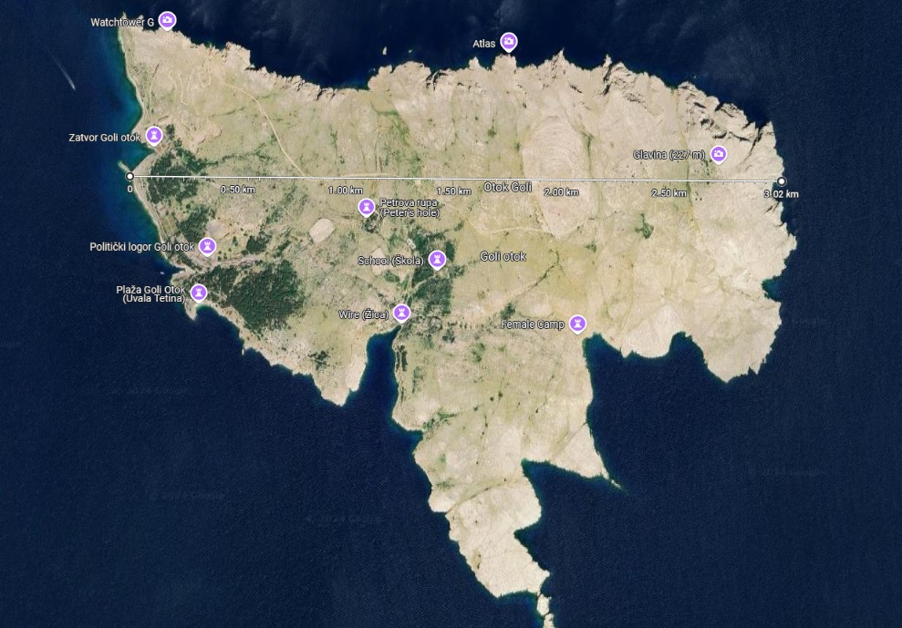
Data: Area 4,54 km², coast line perim 14,3 km, scale 1” = 0.4km.
No | ID | Name | area | perim | x | y | x-LC | y-LC | Iyy | Ixx | Ixy | Ixx0 | Iyy0 | Ixy0 | theta | Imin | Imax | rmin | rmax
1. | 17 | Goli3 | 3.85 | 9.06 | 1.64 | 1.64 | 1.58 | 1.67 | 11.96 | 11.70 | 10.01 | 1.62 | 1.34 | - 0.34 | - 33.87 | 1.11 | 1.85 | 0.54 | 0.69
2. | 20 | Goli6 | 5.35 | 9.35 | 1.59 | 1.59 | 1.56 | 1.61 | 16.59 | 15.47 | 12.94 | 3.14 | 1.99 | - 0.53 | - 21.38 | 1.78 | 3.34 | 0.58 | 0.79
3. | 9 | Goli6x | 4.39 | 10.82 | 1.56 | 1.61 | 1.55 | 1.48 | 13.30 | 12.60 | 10.75 | 2.60 | 1.22 | - 0.29 | - 11.27 | 1.16 | 2.66 | 0.52 | 0.78
4. | 21 | Goli31 | 4.42 | 11.22 | 1.55 | 1.62 | 1.58 | 1.47 | 13.26 | 12.92 | 10.80 | 2.64 | 1.28 | - 0.32 | - 12.63 | 1.21 | 2.71 | 0.52 | 0.78
5. | 22 | Goli250 | 4.37 | 12.80 | 1.56 | 1.61 | 1.56 | 1.48 | 13.26 | 12.66 | 10.72 | 2.57 | 1.27 | - 0.31 | - 12.84 | 1.20 | 2.64 | 0.52 | 0.78
 |  | All
Try it here now….

